Slide 1
DATA Compression

Slide 2
Motivation
“These days the amount of data produced every two days is greater than the entire data produced from 2003”—Eric Schmidt, GOOGLE
So, Data compression is highly needed to allow the data to be stored in an area without taking up any unnecessary amount of space.
Data compression uses a series of algorithms to reduce the amount of real space that the data would normally take up

Slide 3
Objectives
To study different compression techniques for more efficient storage.
To efficiently transfer real time data.
to implement txt file compression technique.
To analyze time and space complexities of Huffman coding.
To implement jpeg image compression technique.(using dct).

Slide 4
Proposed approach
Implementing different huffman Techniques (txt files).
General huffman
Minimum variance huffman
Extended huffman
Adaptive huffman.
Implement jpeg compression technique Using
dct (discrete cosine transform) and Quantization.
ZIG ZAG SELECTION
Huffman encoding.

Slide 5
Algorithms implemented
General Huffman
Minimum variance Huffman
Extended Huffman
Adaptive huffman
Discrete cosine transform
Selective zig zag encoding

Slide 6
General Huffman Technique
Huffman code is a particular type of optimal prefix code that is commonly used for lossless data compression
The algorithm derives this table from the estimated probability or frequency of occurrence (weight) for each possible value of the source symbol
The more the frequency, the less the code length and so more compression
The two least likely letters have the same length code word.

Slide 7
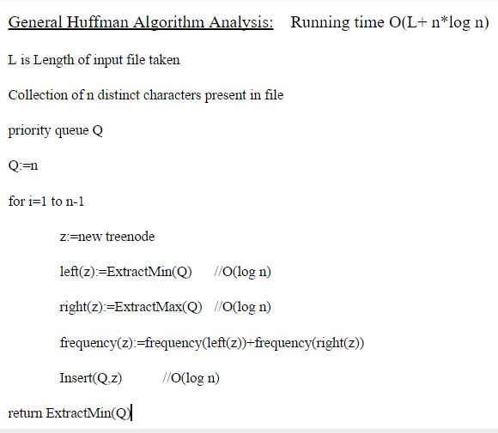

Slide 8
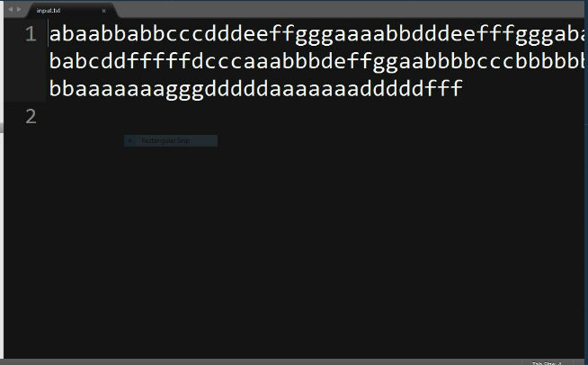
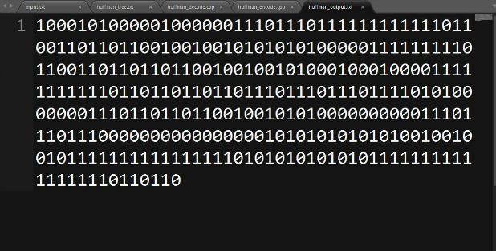
Huffman Input
Huffman output

Slide 9
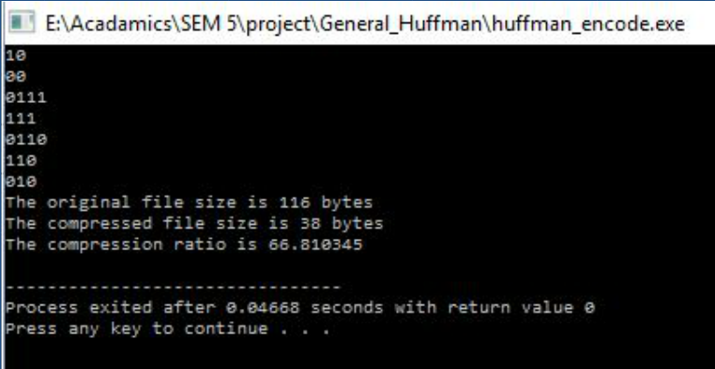
Compression ratio output

Slide 10
File Size

Slide 11
extended Huffman technique
If the probability distribution is very skewed , Huffman codes become inefficient.
We can reduce the rate by grouping symbols together.
This grouping of symbols is implemented in extended Huffman Technique

Slide 12
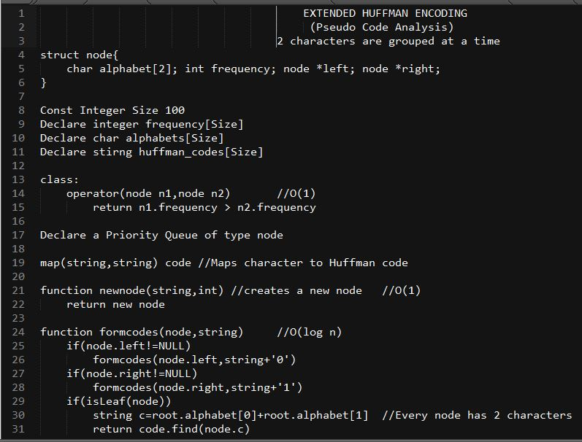

Slide 13
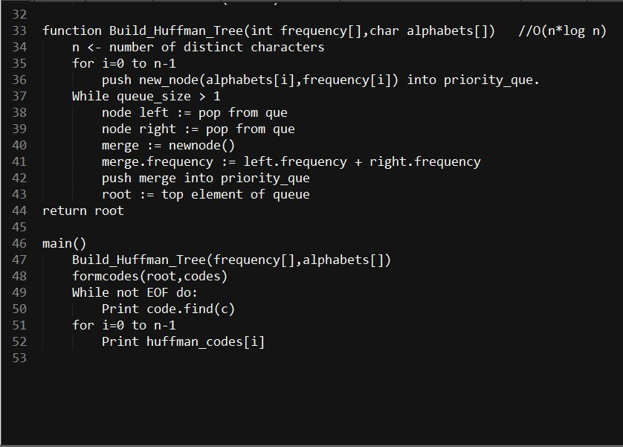

Slide 14
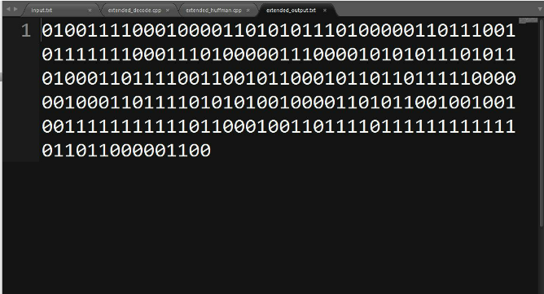
Extended Huffman input

Slide 15
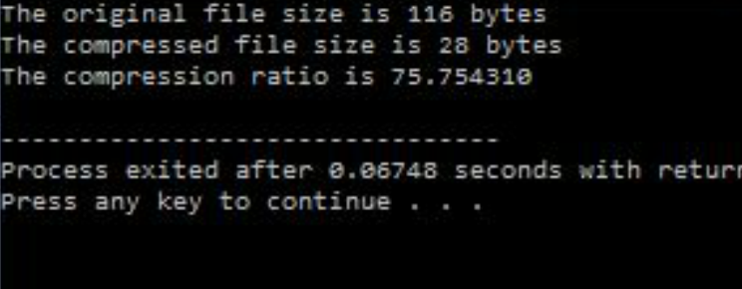
Extended Huffman compression ratio

Slide 16
Adaptive Huffman technique
It permits building the code as the symbols are being transmitted, having no initial knowledge of source distribution, that allows one-pass encoding and adaptation to changing conditions in data.
The benefit of one-pass procedure is that the source can be encoded in real time
procedure - dynamically adjusting the Huffman's tree as data are being transmitted
NYT node - denotes the end of tree. Newly encountered characters if any are inserted here extending the tree forming a new NYT node.

Slide 17
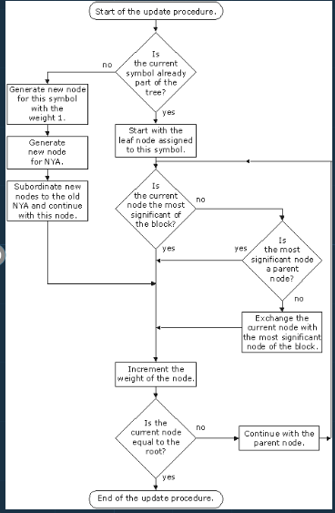

Slide 18
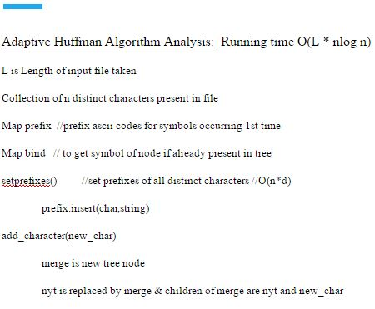

Slide 19
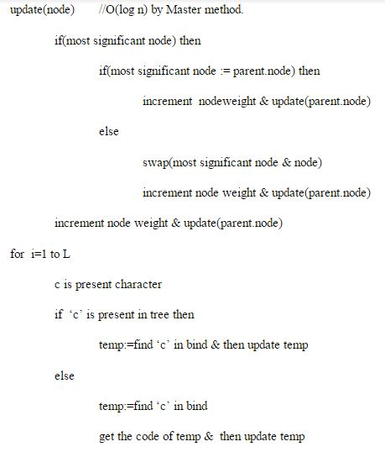

Slide 20
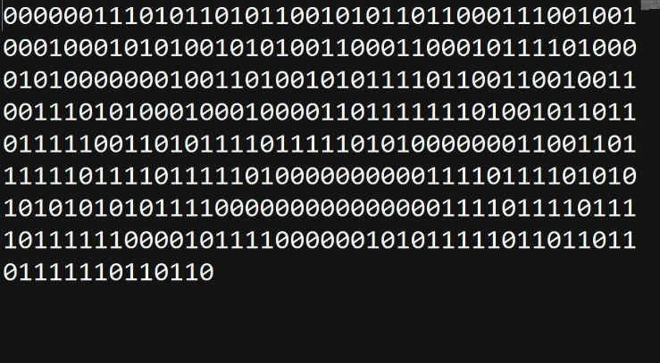
Adaptive Huffman input and output

Slide 21
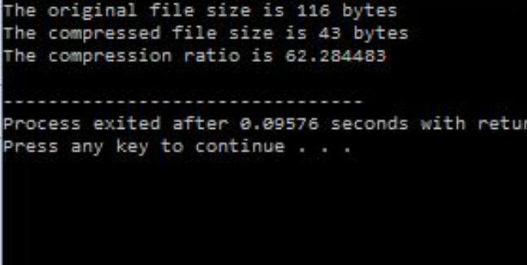
Adaptive Huffman compression ratio

Slide 22
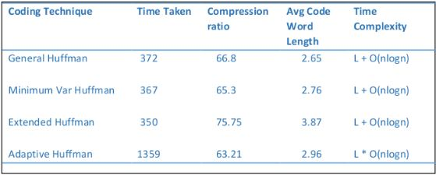
Comparision table

Slide 23
File Size

Slide 26
image compression technique(jpeg)

Slide 27
JPEG
"JPEG" - Joint Photographic Experts Group
JPEG is a commonly used method of lossy compression for digital images.
The degree of compression can be adjusted, allowing a selectable tradeoff between storage size and image quality.
JPEG typically achieves 10:1 compression with little perceptible loss in image quality

Slide 28
Luminance & chrominance
The Human Eye is more sensitive to intensity rather than color. Therefore we make use of this property in the compression technique.
Generally the pixels are in RGB format(red green blue).
The pixels are then converted to YCbCr format.
Y - Luminance component
Cb – Blue chrominance
Cr – Red chrominance.
The main advantage of this conversion is that most of the information that is sensitive to eye is now stored in the luminance component.
Applying the DCT(Discrete Cosine Transform) gives a more favorable output for compression because most of the sensitive data is now stored in DC component.

Slide 29
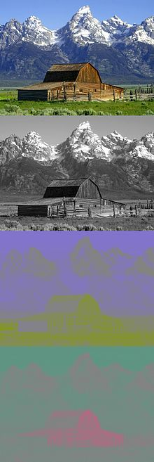
Y - Luminance component
Cb – Blue chrominance
Cr – Red chrominance.

Slide 30
Discrete cosine transform
Converts an image block into it’s equivalent frequency coefficients.
The general equation for a 2D (N by M image) DCT
f(i,j) is the intensity of the pixel in row i and column j
F(u,v) is the DCT coefficient in row u and column v of the DCT matrix.
We divide image into 8x8 blocks and level it by subtracting 128 from each entry (because DCT is designed to work on pixel values ranging from -128 to 127) and now applying DCT.

Slide 31
Discrete cosine transform
This resultant matrix contain 64 DCT coefficients ranging from -1024 to 1023.
For most images, much of the signal energy lies at low frequencies these appear in the upper left corner of the DCT.
Compression is achieved since the lower right values represent higher frequencies, and are often small - small enough to be neglected with little visible distortion.
Therefore DCT transforms the image pixel data into its frequency domain which is more suitable for encoding.

Slide 32
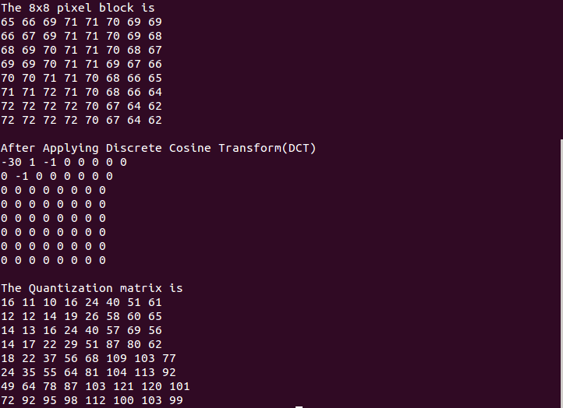
Discrete cosine transform

Slide 33
Quantization
Our 8x8 block of DCT coefficients is now ready for compression by quantization.
This step is where the actual data loss takes place because the DCT coefficients are scaled down to certain level and hence data is lost.
Users decide quantization levels ranging from 1 to 100.
1– poorest quality & highest image compression
100– best quality & lowest compression.
With quality level of 50(Q50), matrix renders both high compression & excellent decompressed image quality.
Quantization is achieved by dividing each element in DCT coefficient matrix by corresponding element in quantization matrix.

Slide 34
Quantization
Coefficients near upper left corner correspond to lower frequencies to which human eye is sensitive and are used to reconstruct image and are called DC components.
The remaining parts of the transformed matrix are called AC components or high frequency components. Hence, they are encoded separately.
It can be observed that the lower right part of the matrix are all zeros after the quantization step. We utilize this property of the DCT to a very good effect resulting in a good compression ratio.
The DC components are usually higher in value compared to the AC components and therefore they are difference encoded(difference of two consecutive DC components is encoded).

Slide 35
SELECTIVE ZIG ZAG ENCODING
After the quantization step is performed and the DCT coefficients are scaled, we have to encode it.
It is observed that most of the data is stored in upper left part of the matrix. Therefore we encode in a zig zag manner.
In the standard JPEG procedure the block is processed entirely in a zig zag procedure.
After some analysis, we observed that a run length of zeros is obtained at the end of every block. Instead of encoding these zeroes, they can be neglected and added to the block while decoding, hence saving up a lot of space.

Slide 36
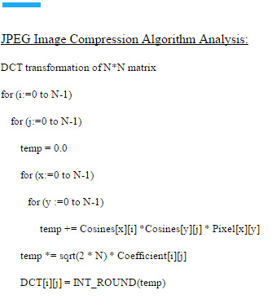

Slide 37
Decompression
JPEG takes advantage by encoding quantized coefficients in zig-zag sequence.
Reconstruction of image begins by decoding the bit stream representing quantized matrix( C ). While decoding, the coefficients of each block are decoded and the rest of the block is filled with zeroes which were ignored in the encoding process. Each element of quantized matrix multiplied with quantization matrix to get original non-quantized DCT matrix.
Ri,j = Qi,j * Ci,j

Slide 38
Decompression
Now Inverse DCT (IDCT) is applied to R. It is the inverse function of DCT.
N = (T'RT) + 128.
Now the original image pixel matrix is recovered with marginal difference from the original matrix arising due to data loss. Now this matrix is used to form the compressed image which is of much smaller size but similar quality.

Slide 39
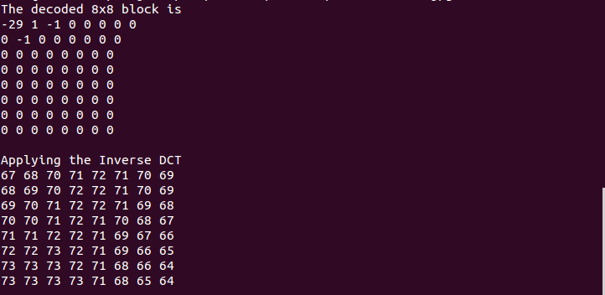
INVERSE Discrete cosine transform

Slide 40
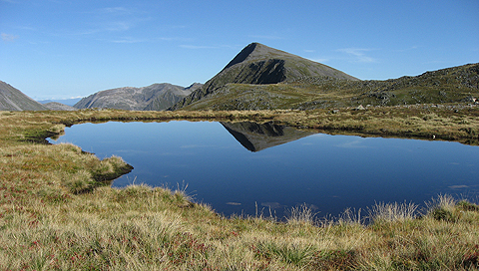

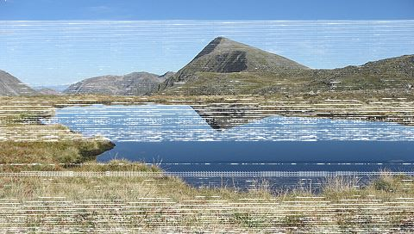
RESULTS
Original BMP Image – 392KB
Compressed JPG image – 35.3KB
Facebook – 38.1KB

Slide 41
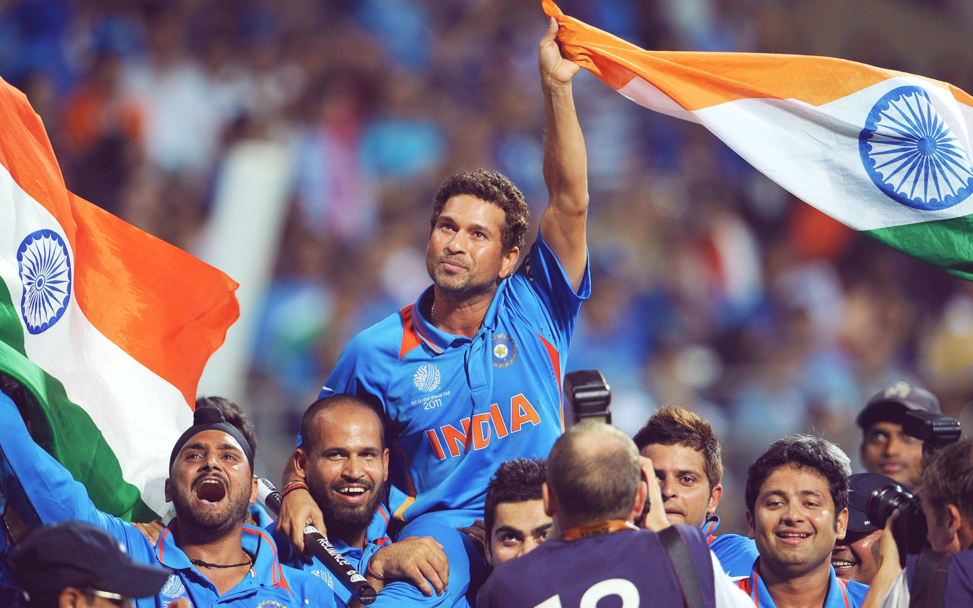

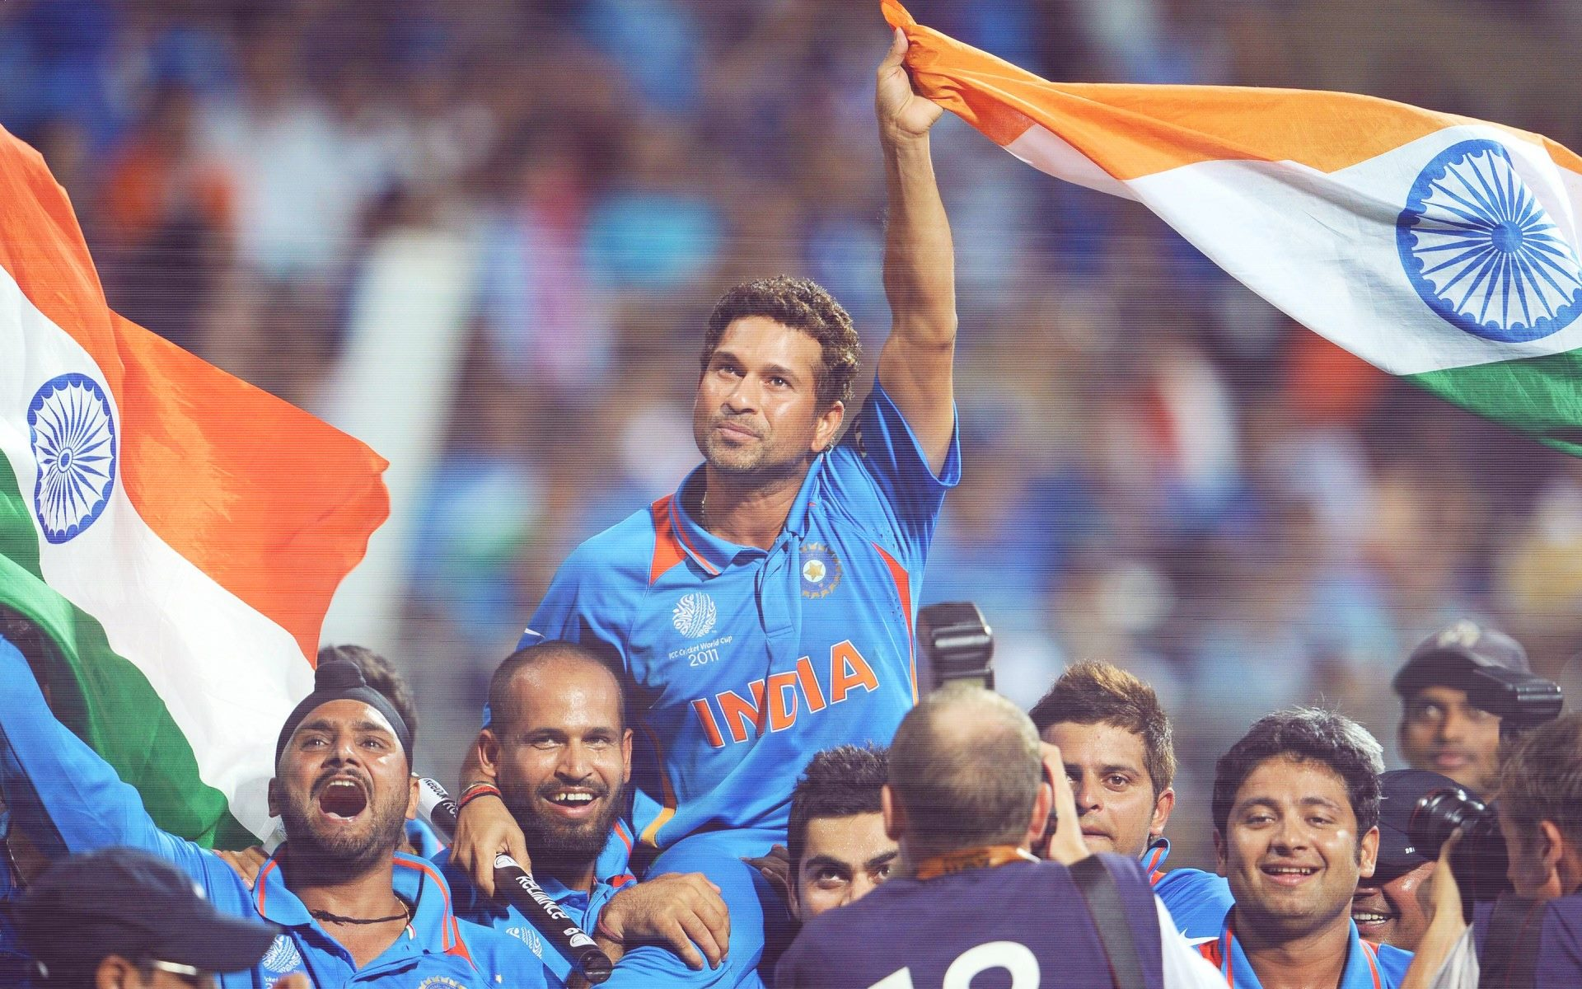
RESULTS
Original BMP Image – 6.9MB
Compressed JPG image – 403KB
Facebook – 404KB

Slide 42
RESULTS
S. NO | Image Name | Size | JPEG Size | Q(Quality level)
1 | Nature | 391.8KB | 26.7KB | 25
2 | Nature | 391.8KB | 43.2KB | 75
3 | Nature | 391.8KB | 35.3KB | 50
4 | Nature | 391.8KB | 51.9KB | 90
5 | Nature | 391.8KB | 32.6KB | Facebook
6 | Sachin | 6.9MB | 407KB | 50
7 | Sachin | 6.9MB | 466.6KB | 75
8 | Pattern | 741.5KB | 33.3KB | 25
9 | Pattern | 741.5KB | 47.2KB | 50
10 | Pattern | 741.5KB | 57.5KB | 75
11 | Pattern | 741.5KB | 58.2KB | 90
12 | Pattern | 741.5KB | 97KB | Facebook

Slide 43
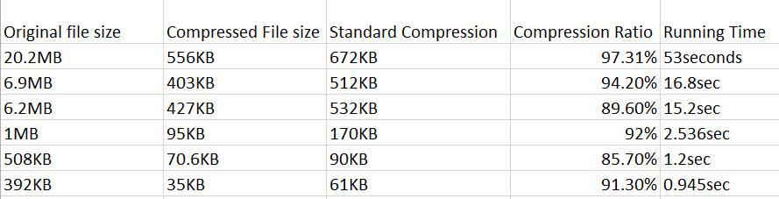
RESULTS

Slide 46
references
MIT Opencourseware – DAtaCompression
https://courses.cs.washington.edu/courses/csep590a/07au/lectures/lecture02small.pdf
http://www.binaryessence.com/dct/en000111.html
Introduction to Data Compression – Khalid Sayood
Complete Reference to Data Compression -- David Salomon

Slide 47
Special Thanks to Dr.Satish K Singh
Arun Kumar Reddy (IRM2014005)
Sannhith Kavala (IHM2014004)
Pruthvi Anvesh (ITM2014012)
Pranay Kumar (IIT2014136)

Slide 48
THANK YOU

